Slide 1
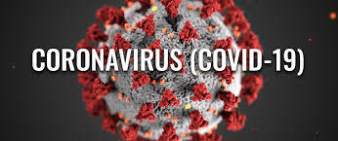
Coming Back from COVID-19: A Short-Term Portfolio Plan
Project One

Slide 2
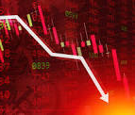
Harold’s Predicament
Harold is evaluating his portfolio at the end of April and believes the market volatility in March and April present a strong short-term investing opportunity. He believes the market trajectory will be positive as the economy rebounds and state lockdowns lift. He is not dependent on this portfolio’s returns for current income needs and is most interested in the best aggregate return over the next few months for US-listed companies. He wants to test the projected returns of several possible, 4-investment portfolios with an initial investment of $10,000.

Slide 3




Communication Services – The “__Remotely” Portfolio
Components:
AT&T, T, $213 billion market capitalization
Charter Communications, CHTR, $120 billion
Comcast, CMCSA, $170 billion
Verizon Communications, VZ, $ 235 billion
Investment Thesis: Harold suspects the mass shift to working, studying, entertaining remotely from home will not subside immediately. Even as the lockdowns are removed, the lack of a vaccine and potential reticence on the part of employers, schools and other businesses to return to pre-COVID-19 operating procedures may fail to materialize right away. Harold thinks a communications services portfolio consisting of the two dominant cell phone carriers (T & VZ) as well as and two leading national cable providers (CMCSA & CHTR) should benefit from this trend and potentially outperform the broader market.

Slide 4
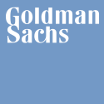


Financial Services – A “Stimulating” Portfolio
Components:
Bank of America, BAC, $200 billion market capitalization
Goldman Sachs, GS, $600 billion
PayPal, PYPL, $170 billion
Visa, V, $ 235 billion
Investment Thesis: While Harold is concerned about the long-term effect of the $2.8 trillion in aggregate fiscal stimulus (so far) and $2.5 trillion expansion of the Federal Reserve balance sheet to support the economy during the pandemic, he believes the enormous infusion of liquidity and fiscal relief could make financials a compelling sector to invest in for the short-term. Banks have been provided $669 billion in Treasury-backed, forgivable small business loans to disburse and will be central to a broader recovery. Harold chose BAC as it is the universal bank with the widest footprint. Online payments leader PYPL and V, the world’s largest credit card provider, offer ample exposure to the increasing shift to online and digital purchases. A significant improvement in consumer spending from extremely low levels during the depths of the crisis should boost these stocks strongly. The economic disruption could also accelerate M&A as firms may be forced to combine to shore up damaged balance sheets and extract cost efficiencies while the regulatory environment is favorable. The world’s leading pure-play investment bank, GS, was added to help the portfolio benefit from this trend.

Slide 5
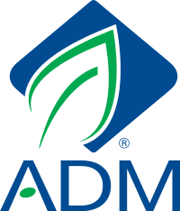
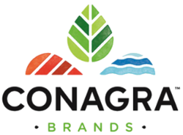


Food – An “Essential” Portfolio
Components:
Archer Daniels Midland, ADM, $20 billion market capitalization
ConAgra, CAG, $16 billion
Hormel, HRL, $25 billion
Tyson Foods, TSN, $ 22 billion
Investment Thesis: In a time of segmenting workers by ‘essential’ or ‘non-essential’, Harold thinks a purely non-discretionary industry like food has the potential to generate strong performance whether the economy struggles to regain traction or not. Even if COVID-19 has shifted consumption away from restaurants and in favor of grocery stores and delivery services. Accordingly, Harold two dominant food processing companies (ADM, TSN) and two major packaged foods companies (CAG, HRL).

Slide 6




Pharma – The “Pandemic-Proof” Portfolio
Components:
Abbott Laboratories, ABT, $160 billion market capitalization
Johnson & Johnson, JNJ, $390 billion
Merck, MRK, $195 billion
Pfizer, PFE, $210 billion
Investment Thesis: Harold wants to ensure he has more than one non-discretionary portfolio option to evaluate. Like food, the pharma industry is essential and during a severe health crisis, he thinks the industry tailwinds would be strong as the country intensifies its focus on maintaining good public health. ABT, JNJ, MRK and PFE represent a wide swath of the US-based pharma sectors. However, Harold is reticent to make a specific binary bet on the winner of a vaccine to fight the SARS-coV-2 virus, which is why he excluded Gilead from the portfolio. In the event the economic recovery stalls, these leading pharma companies would also provide a strong defensive play if the market rolls over.

Slide 7

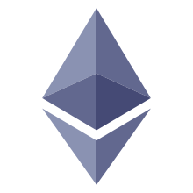

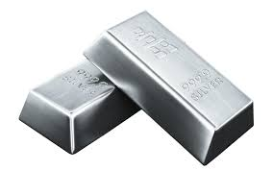
Hedge – The “Chaos” Portfolio
Components:
Bitcoin, BTC, $165 billion market capitalization
Ether, ETH, $23 billion
SPDR Gold Shares, GLD, $42 billion
iShares Silver Trust, SLV, $14 billion
Investment Thesis: Harold insists we also test a basket of investments that could present non-correlated characteristics to portfolios with widely-held equities. He selected the two major cryptocurrencies (BTC, ETH) along with two major funds tracking major precious metals (GLD, SLV). Though Bitcoin and Ether have not surpassed high watermarks set in 2017, Harold believes this presents a good investment opportunity for the chance there is mainstream adoption and bull run. Bitcoin has a unique value proposition replicating the scarcity gold and silver but in a digital fashion. Bitcoin boasts a fixed supply cap of 21 million coins, arguably a hedge against exploding budget deficits and extreme monetary policy as evidenced by crashing Treasury yields. The Ethereum network is underway a several year transition period to move from a Proof of Work model to Proof of Stake model. To participate in Proof of Stake, holders lock their Ether in a smart contract thus lowering available circulating supply. Gold has been universally trusted as a defense against hyperinflation, chaotic monetary policy and economic uncertainty for thousands of years in addition to its use for jewelry and in some industrial applications. Though gold has traditionally been favored over silver in expressing these themes, Harold also wanted silver (SLV) represented due to the extreme 114 gold-to-silver ratio which is significantly above long-term averages in case of short-term retracement toward the 20-year average of 60.

Slide 8




MONTE CARLO SIMULATIONS
Communication Services
Hedge
Food
& 90% Confidence Intervals
Financials
Pharma

Slide 9
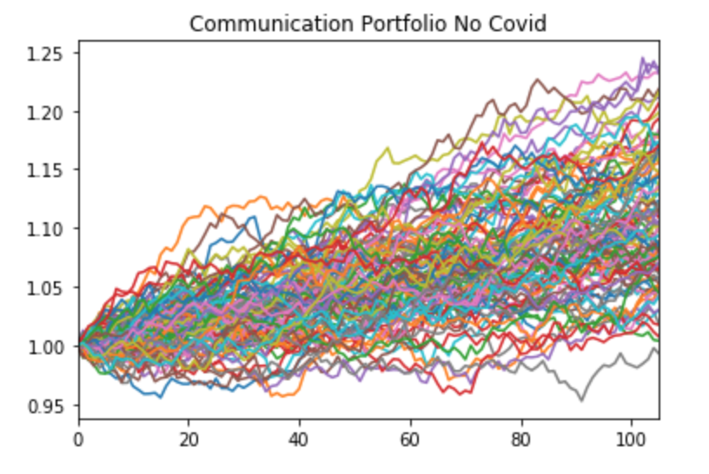
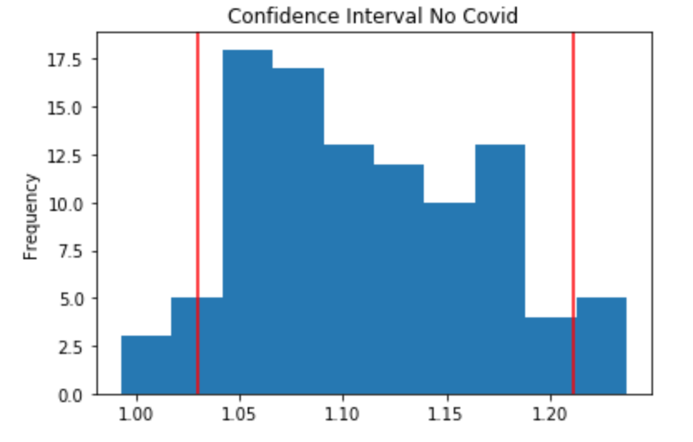
Monte Carlo – Communications – No COVID-19
We project a 90% probability that an initial investment of $10,000 would have produced a portfolio value over the next five months between $10,300 and $12,118, if the COVID-19 pandemic had not occurred.

Slide 10
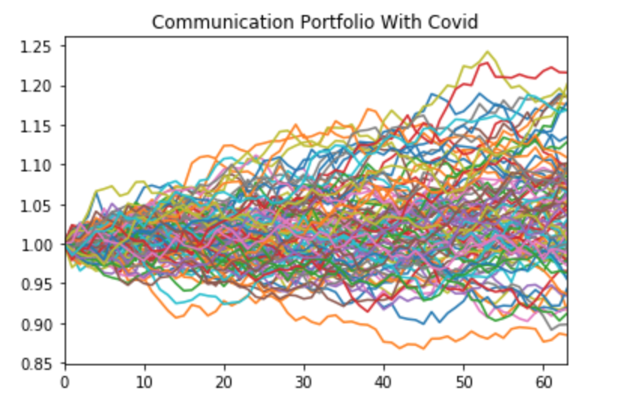
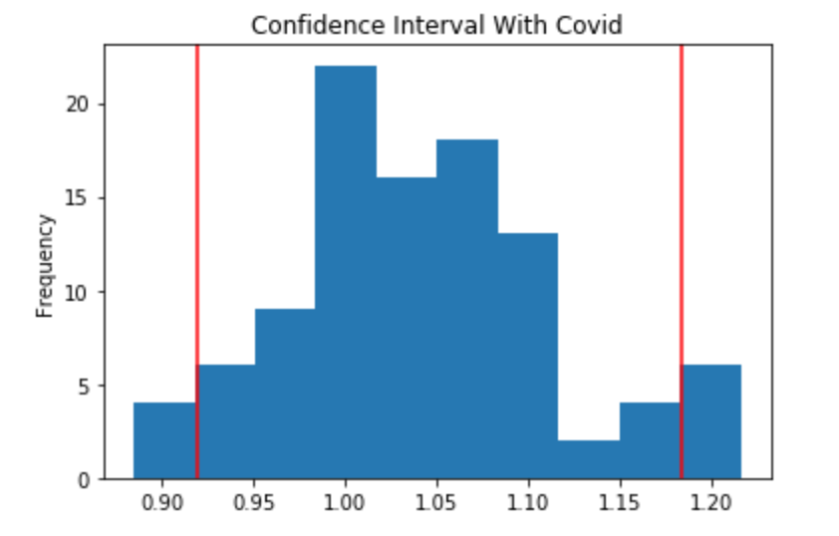
Monte Carlo – Communications – Post-COVID-19
We project a 90% probability that an initial investment of $10,000 will produce a portfolio value over the next three months between $9,196 and $11,836.

Slide 11
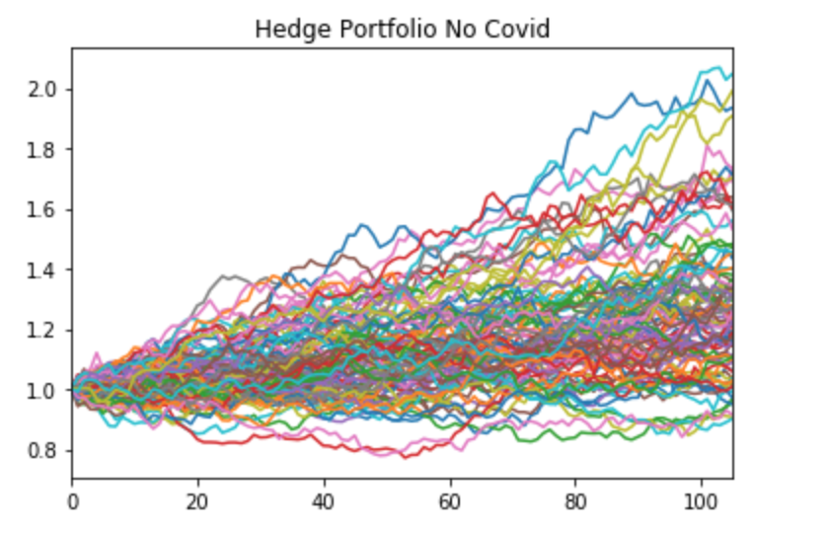
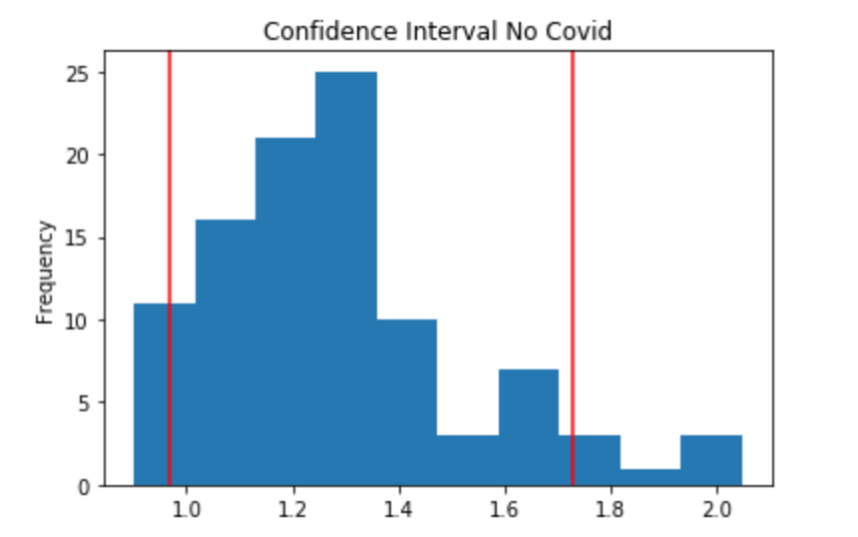
Monte Carlo – Hedge – No COVID-19
We project a 90% probability that an initial investment of $10,000 would have produced a portfolio value over the next five months between $9,671 and $17,293, if the COVID-19 pandemic had not occurred.

Slide 12
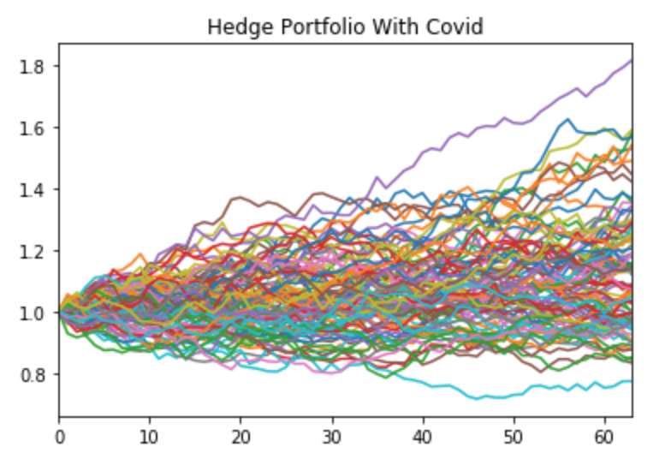
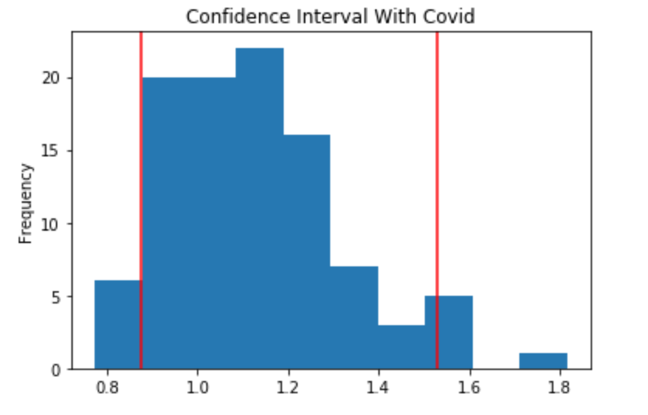
Monte Carlo – Hedge – Post-COVID-19
We project a 90% probability that an initial investment of $10,000 will produce a portfolio value over the next three months between $8,765 and $15,294.

Slide 13
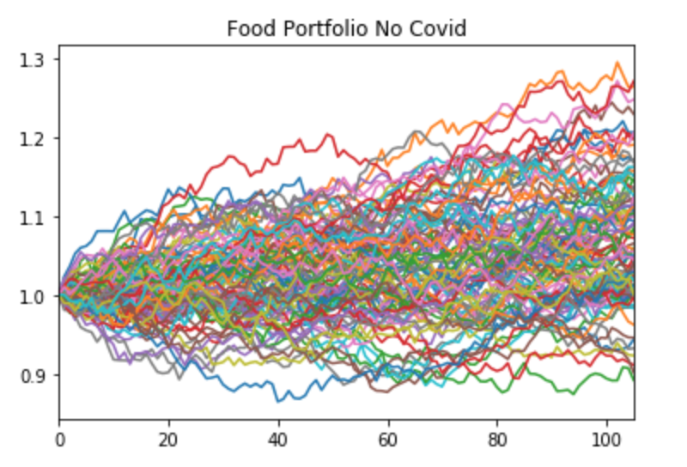
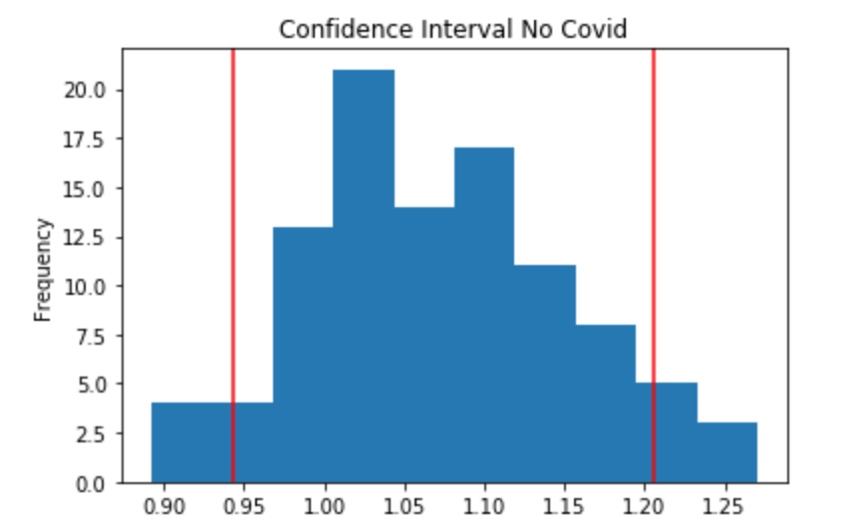
Monte Carlo – Food – No COVID-19
We project a 90% probability that an initial investment of $10,000 would have produced a portfolio value over the next five months between $9,431 and $12,052, if the COVID-19 pandemic had not occurred.

Slide 14
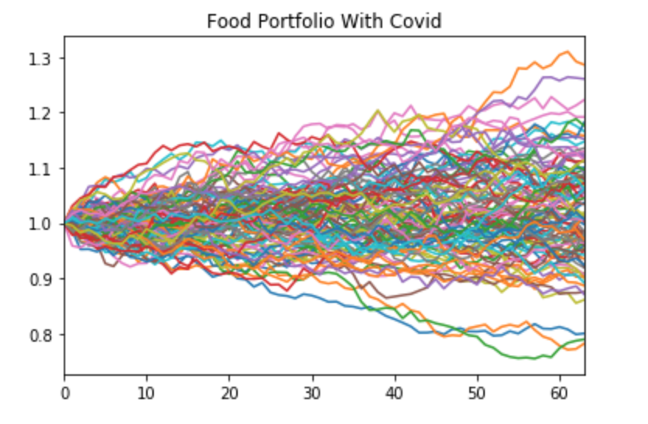
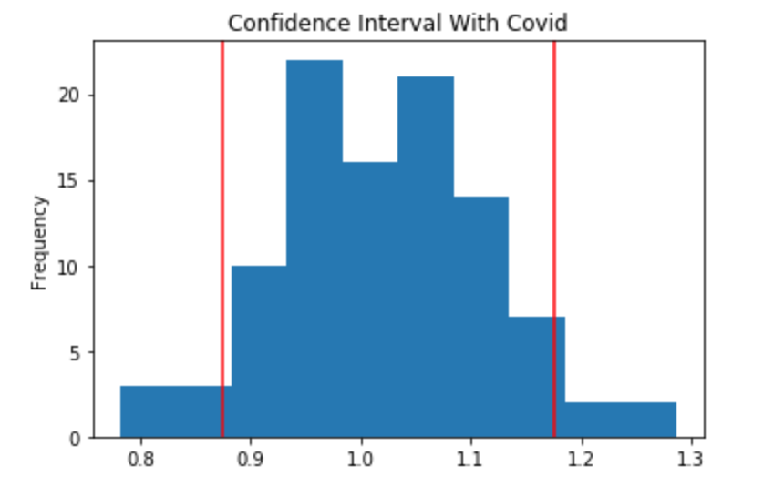
Monte Carlo – Food – Post-COVID-19
We project a 90% probability that an initial investment of $10,000 will produce a portfolio value over the next three months between $8,754 and $11,761.

Slide 15
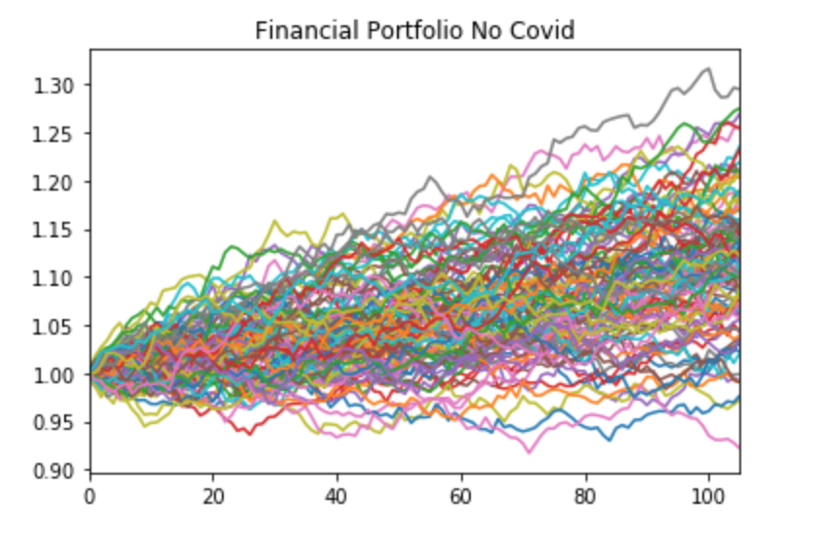
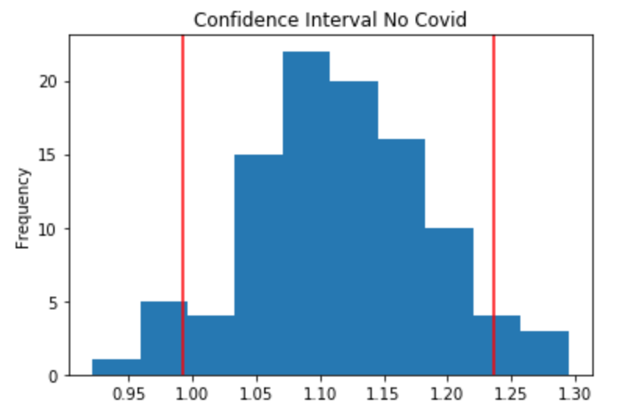
Monte Carlo – Financials – No COVID-19
We project a 90% probability that an initial investment of $10,000 would have produced a portfolio value over the next five months between $9,920 and $12,369, if the COVID-19 pandemic had not occurred.

Slide 16
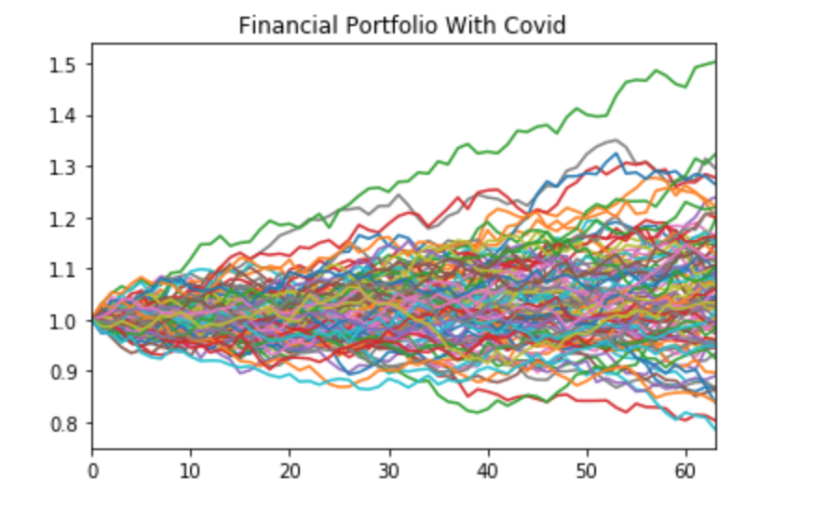
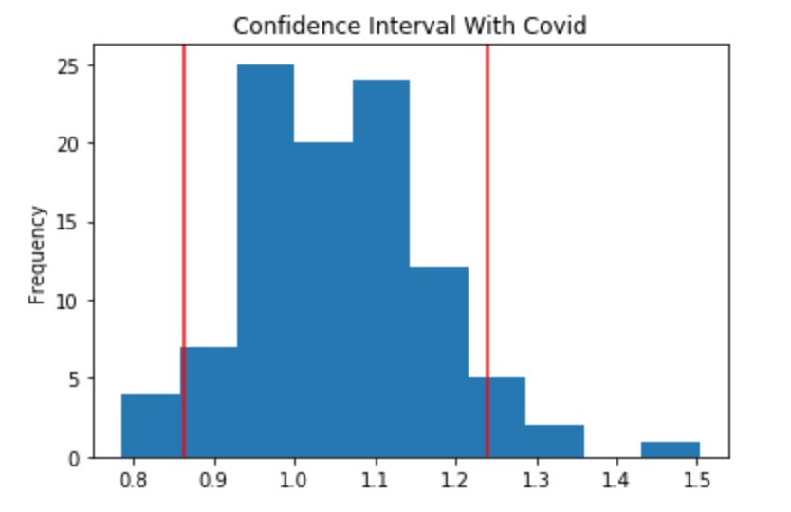
Monte Carlo – Financials – Post-COVID-19
We project a 90% probability that an initial investment of $10,000 will produce a portfolio value over the next three months between $8,640 and $12,398.

Slide 17
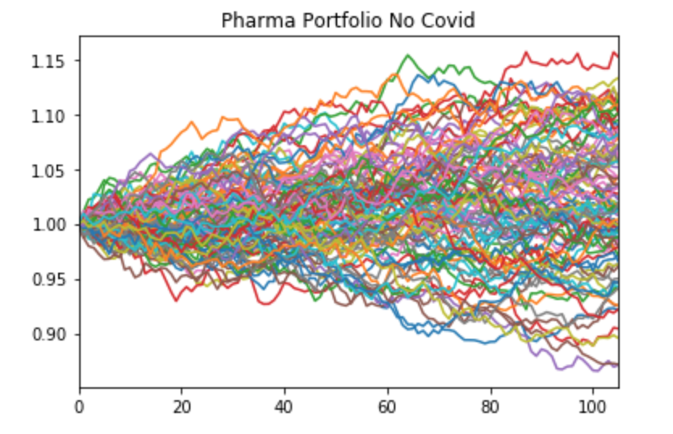
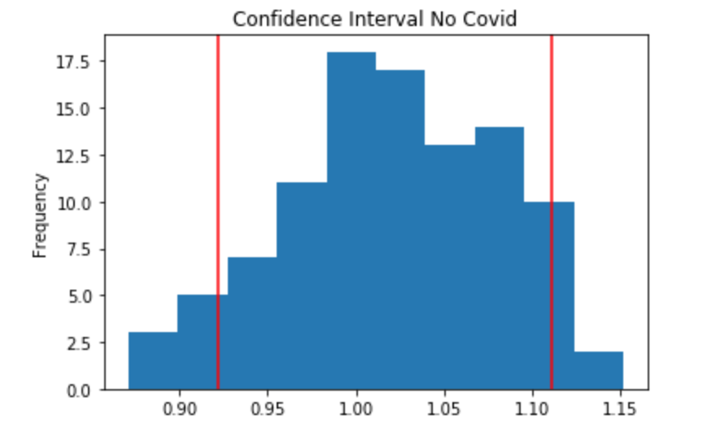
Monte Carlo – Pharma – No COVID-19
We project a 90% probability that an initial investment of $10,000 would have produced a portfolio value over the next five months between $9,220 and $11,109, if the COVID-19 pandemic had not occurred.

Slide 18
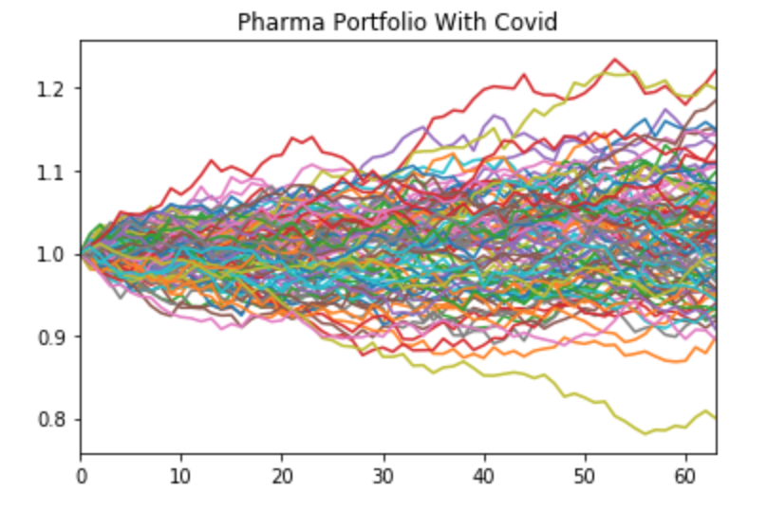
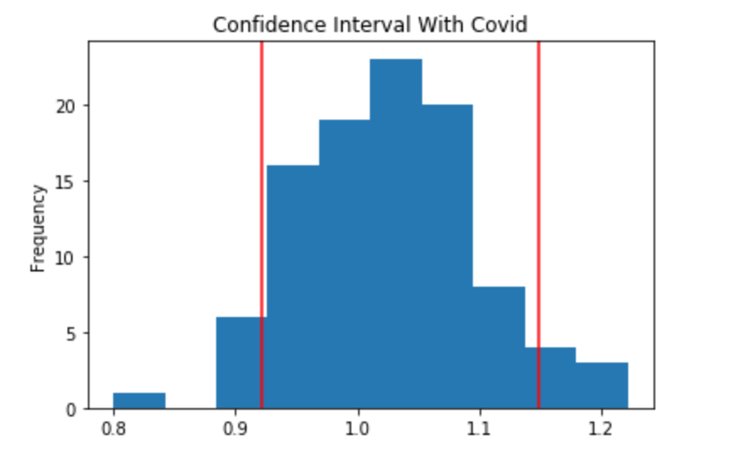
Monte Carlo – Pharma – Post-COVID-19
We project a 90% probability that an initial investment of $10,000 will produce a portfolio value over the next three months between $9,214 and $11,479.

Slide 19
Sharpe Ratios – Risk-Adjusting Each Portfolio
Given the volatility introduced by COVID-19, Harold wants to also know the inherent riskiness of each projected portfolio as well.
We calculated Sharpe ratios for each component of each portfolio and drew the following conclusions: The post-COVID-19 Sharpe ratios are: Communications (1.42), Financials (1.34), Hedge (1.29), Food (0.70), Pharma (0.31). This suggests returns carry a higher risk premium per unit of risk in the Communications, Financials and Hedge portfolios than in the Food and Pharma portfolios.
COVID-19 reduced portfolio Sharpe ratios by an average -0.44. Communication Services (-0.97) and Financials (-0.94) declined the most followed by Hedge (-0.48), Food (-0.32) and Pharma (-0.01).

Slide 20

CONCLUSIONS
Option 1: If Harold confirms he wants to stretch for the highest potential return over the next three months, he should select the HEDGE portfolio.
Monte Carlo simulations showed the upper bound of the 90% confidence interval range at $15,294 which was the highest among the five portfolios.
Option 2: If Harold wants to limit the potential for losses over the next three months, he should select the PHARMA portfolio.
Monte Carlo simulations showed the lower bound of the 90% confidence interval range at $9,214 which was the highest among the five portfolios. It also has the tightest band between bounds with a spread of only $2,265. Though the ranges of the confidence intervals compare closely with Communication Services and Financials, the significant drop in Sharpe ratios experienced by these two portfolios made Pharma the clear winner in a maximum lower-bound strategy.

